Slide 1
CONTRIBUTING TO STABILITY AND PEACE IN CENTRAL ASIA
THROUGH MEDIA LITERACY, IMPROVED REPORTING AND REGIONAL COOPERATION
RUSSIA
GEORGIA
CYPRUS
TURKEY
KAZAKHSTAN
ARMENIA
AZERBAIJAN
MONGOLIA
LEBANON ISRAEL
SYRIA
IRAQ
UZBEKISTAN TURKMENISTAN
KYRGYZSTAN
ORDAN
IRAN
TAJIKISTAN
CHINA
SAUDI ARABIA
KUWAIT
AFGHANISTAN
QATAR
AE
OMAN
PAKISTAN
NEPAL
YEMEN
INDIA
MYANMAR
LAOS
BANGLADHES
THAILAND
CAMBO

Slide 2
CONCEPT
1 1
TARGETS
RESULTS
Regional research on the information ecosystem in Central Asia
The research is aimed to identify and analyses the local drivers of extremist sympathies, pertinent information flows, trusted sources of information, and what types of support are needed in order to amplify respected, moderate local voices.
The research is done in partnership with Search for Common Ground in Kyrgyzstan (SCGK), Civil Initiative for Internet Policy (CIIP) Public Foundation and SecDev Foundation.

Slide 3
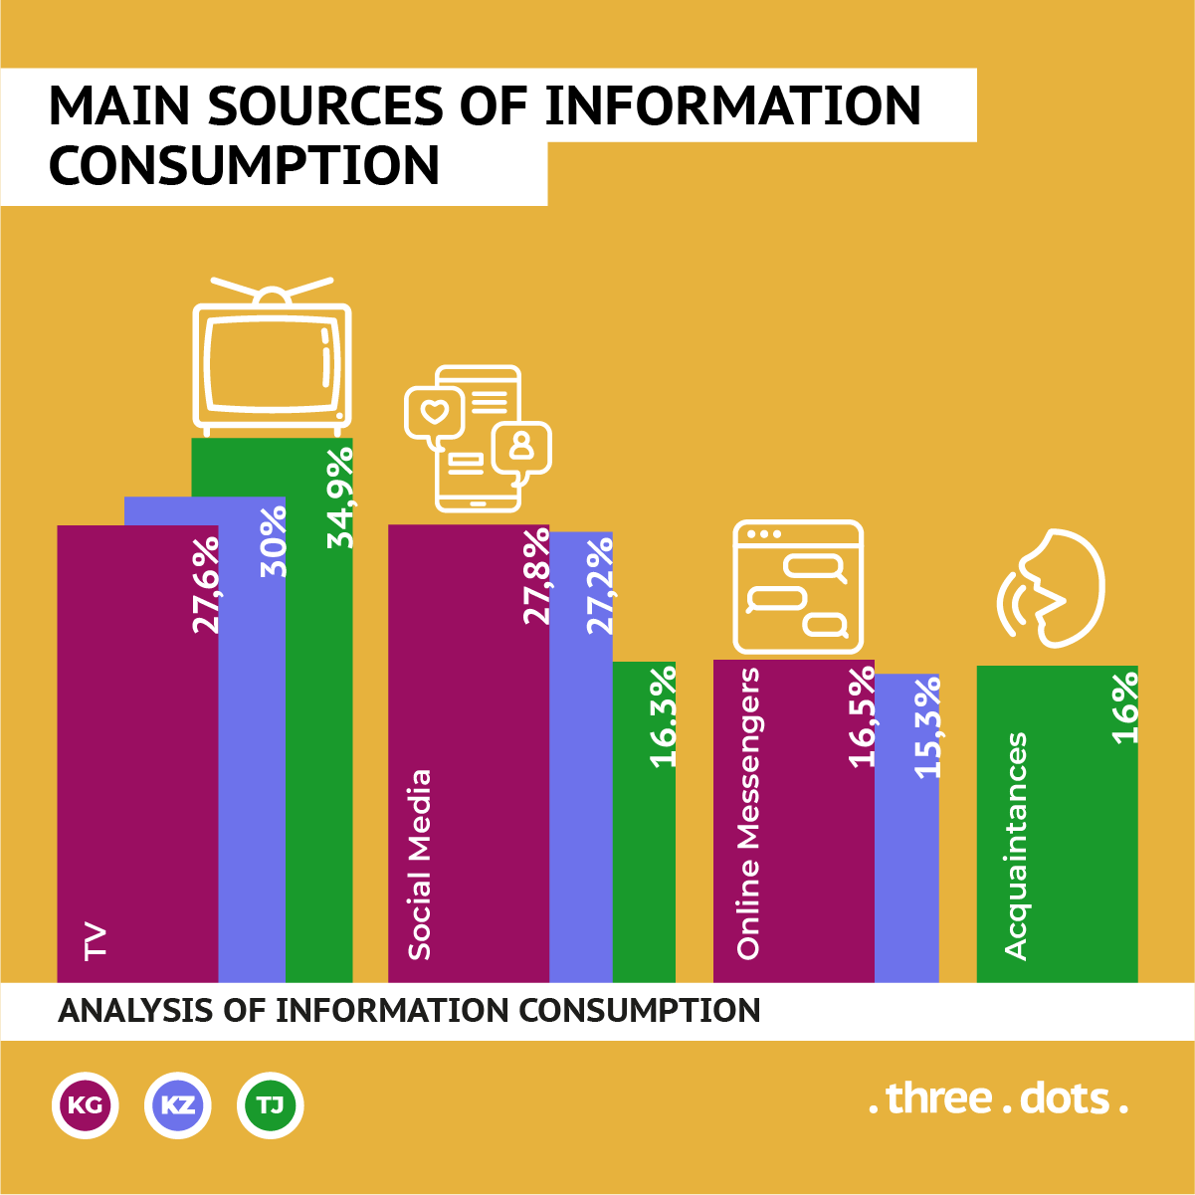
REGIONAL RESEARCH

Slide 4
REGIONAL RESEARCH

Slide 5
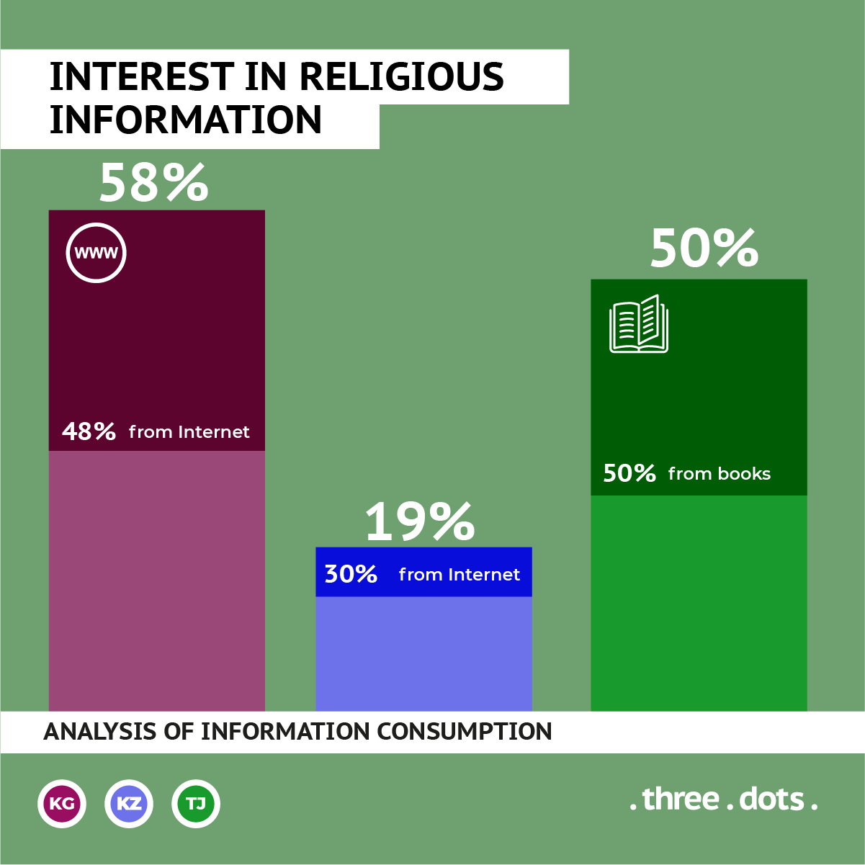
REGIONAL RESEARCH

Slide 6
August 2018 October 2018
REGIONAL RESEARCH
246 140
Accounts were found containing VE content
Accounts were actively promoting VE content
324 000
Subscribers on those accounts

Slide 7
REGIONAL RESEARCH
Content blocking and takedowns
have had only limited efficiency
in reducing the amount of VE content
Education and engagement have
been far more effective

Slide 8
CONCEPT
Supporting national and regional initiatives, contributing to preventing radicalization in Central Asia
Capacity building
Increasing the level of critical media consumption
journalists
activists
representatives of governmental agencies
active citizens
representatives of governmental agencies
media professionals

Slide 9
CONCEPT
Supporting national and regional initiatives, contributing to preventing radicalization in Central Asia
Capacity building
journalists
activists
representatives of governmental agencies

Slide 10
CONCEPT
Supporting national and regional initiatives, contributing to preventing radicalization in Central Asia
Increasing the level of critical media consumption
active citizens
representatives of governmental agencies
media professionals

Slide 11
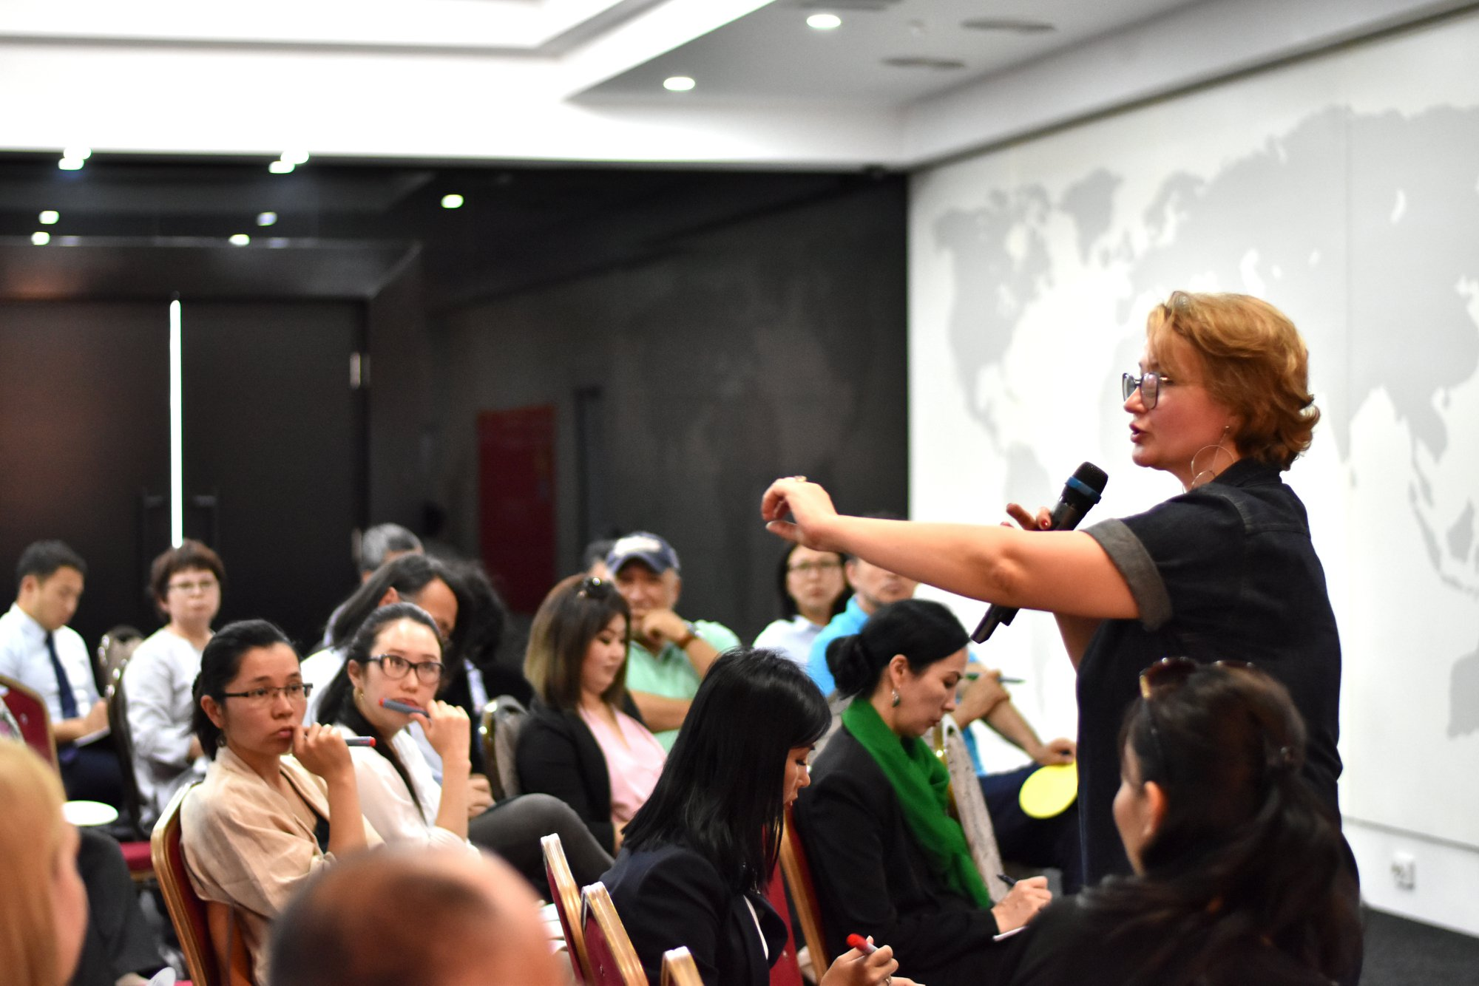
THANK YOU!
FARHOD RAHMATOV
PROJECT DIRECTOR
FRAHMATOV@INTERNEWS.ORG WWW.INTERNEWS.ORG TWITTER: @INTERNEWS FACEBOOK.COM/INTERNEWS

